Slide 1
Math 170 Functions, Data, and Models
31 Periodic Functions
Sections 7.4-5

Slide 2
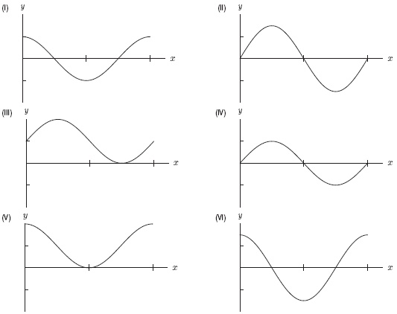
1. Match the graphs in Figure 6.3 to the following list of functions.
y = sinx
y = cosx
y = 1+ sinx
y = 1+ cosx
y = (3/2)sinx
y = (3/2)cosx
ConcepTest • Section 7.3• Question 1

Slide 3
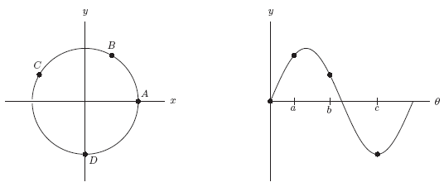
2. In Figure 7.4, which of the following describes the relationship of the unit circle and the graph of the sine function.
Figure 7.4: The unit circle and the sine function graph
They have the same axes
The vertical axis is the same but the horizontal axis is different
The horizontal axis is the same but the vertical axis is different
Neither axis is the same
There is no relation between these 2 graphs
ConcepTest • Section 7.3• Question 2

Slide 4
Cosine, Sine, and Tangent
Angles are measured counterclockwise from the positive horizontal with 360 degrees corresponding to one full revolution.
If $P=(x,y)$ is the point of the unit circle specified by angle $θ$, then $\cos{θ}=x$, $\sin{θ}=y$, and $\tan{θ}=y/x$.
Construct a table of cosine, sine, and tangent at 0, 30, 45, 60, 90, …, 330 degrees.
Draw graph of tangent on the domain -90 to 450 degrees and the codomain -3 to 3.
Determine the domain, range, midline, amplitude, and period of the tangent function.

Slide 5
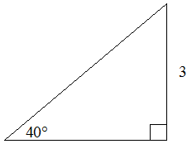
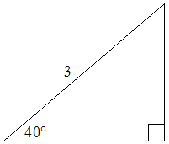
Right Triangle Trigonometry
Find the side and angle measurements for the given triangles.

Slide 6
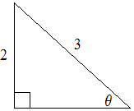
Right Triangle Trigonometry
For each figure, find $\cos{θ}$, $\sin{θ}$, and $\tan{θ}$ exactly.

Slide 7
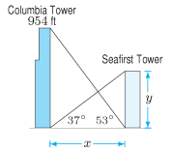
Applications
7.4 #26. The front door to the student union is 20 feet above the ground, and it is reached by a flight of steps. The school wants to build a wheelchair ramp, with an incline of 15 degrees, from the ground to the door. How much horizontal distance is needed for the ramp?
7.4 #32 Knowing the height of the Columbia Tower in Seattle, determine the height of the Seafirst Tower and the distance between the towers.

Slide 8
Inverse Trigonometric Functions
Consider a right triangle with one side 4 meters and hypotenuse 13 meters. What is the length of the other side and the values of the two non-right angles?
Do the trigonometric functions have inverses?

Slide 9
Right Triangle Trigonometry
Find the side and angle measurements for the given triangles.

Slide 10
Applications
7.5 #38. You want to build a wheelchair ramp leading up to your house. Your front door is 2 feet higher than the driveway and you would like the grade of the ramp to be 7%.
What is the angle that the ramp forms with the driveway?
How long does the driveway have to be to build this ramp?
How long will the ramp be?
7.5 #42. A staircase is to rise 17.3 feet over a horizontal distance of 10 feet. At approximately what angle with respect to the floor should it be built?

Slide 11
2. Let arcsin 4/5 = x. Compute the following without using a calculator.
(a) cos x
(b) tan x
ConcepTest • Section 7.5• Question 2

Slide 12
3. Simplfy sin(arctan x) as an expression that involves only the term x.
ConcepTest • Section 7.5• Question 3

